Slide 1
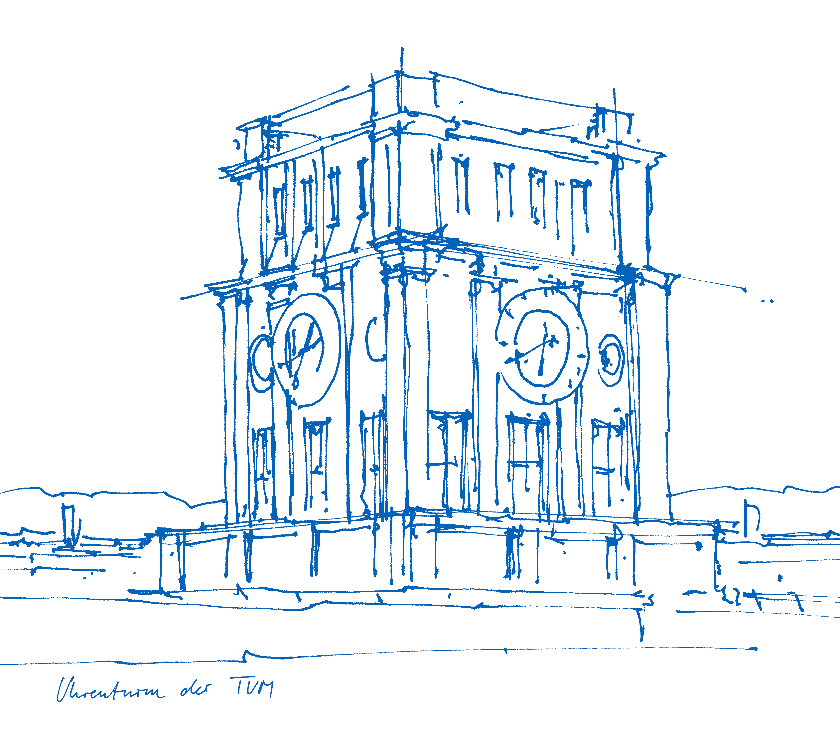
Name
Technical University of Munich
Chair for Cognitve Systems
Place, xx. Januar 2016

Slide 2
Prof. Gordon Cheng
Date

Slide 3
Font
Font: Arial
Font size :30 | 22 | 16 | 12

Slide 4
Pictures
Header

